Slide 1

Chapter Two
Intelligent Agents

Slide 2
Learning objectives.
2.1 Introduction 2.1.1 Agent Terminology
2.1.2 Environment of Problem
2.1.3 Vacuum cleaner problem
2.2 Structure of Agent
2.2.1 PAGE
2.2.2 Agent program
2.2.3 Attributes of Agents
2.3 Rationality
2.3.1 Rational Agent
2.3.2 Ideal rational agent
2.3.3 Autonomy
2.4 Types of Agent
2.5 Environment and properties
2.6 PEAS for Agent
2.7 Intelligent agent application
After this chapter , students will be able to :
Understand the concept of artificial intelligent agent
Understand the basic concept of rationality
Interpret and apply fundamental of type of agent on current problems related to artificial intelligence.

Slide 3
2.1 Introduction 2.1.1 Agent Terminology
2.1.2 Environment of Problem
2.1.3 Vacuum cleaner problem
2.2 Structure of Agent
2.2.1 PAGE
2.2.2 Agent program
2.2.3 Attributes of Agents
2.3 Rationality
2.3.1 Rational Agent
2.3.2 Ideal rational agent
2.3.3 Autonomy
2.4 Types of Agent
2.5 Environment and properties
2.6 PEAS for Agent
2.7 Intelligent agent application
Intelligent systems
Intelligent systems are the frameworks or a system that may show a type of knowledge. This knowledge was made by preparing the framework with information, however, not utilizing the explicit programming. For example, a less complex smart framework/system could be the Gmail spam classifier.

Slide 4
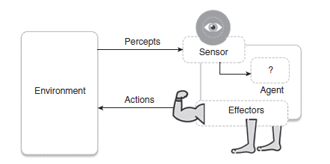
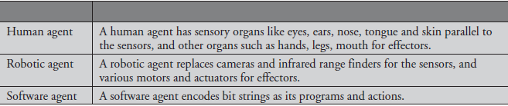
2.1 Introduction 2.1.1 Agent Terminology
2.1.2 Environment of Problem
2.1.3 Vacuum cleaner problem
2.2 Structure of Agent
2.2.1 PAGE
2.2.2 Agent program
2.2.3 Attributes of Agents
2.3 Rationality
2.3.1 Rational Agent
2.3.2 Ideal rational agent
2.3.3 Autonomy
2.4 Types of Agent
2.5 Environment and properties
2.6 PEAS for Agent
2.7 Intelligent agent application
Intelligent agent
An agent is defined something that sees (perceives) and acts in an environment. IAs perform task that will be beneficial for the business procedure, PC application or a person.

Slide 5
2.1 Introduction 2.1.1 Agent Terminology
2.1.2 Environment of Problem
2.1.3 Vacuum cleaner problem
2.2 Structure of Agent
2.2.1 PAGE
2.2.2 Agent program
2.2.3 Attributes of Agents
2.3 Rationality
2.3.1 Rational Agent
2.3.2 Ideal rational agent
2.3.3 Autonomy
2.4 Types of Agent
2.5 Environment and properties
2.6 PEAS for Agent
2.7 Intelligent agent application
Agent terminology
Performance measure of agent: It is the criteria determining the success of an agent.
Behaviour/action of agent: It is the action performed by an agent after any specified sequence of the percepts.
Percept: It is defined as an agent’s perceptual inputs at a specified instance.
Percept sequence: It is defined as the history of everything that an agent has perceived till date.
Agent function: It is defined as a map from the precept sequence to an action.
Agent function, a = F(p)
where p is the current percept, a is the action carried out, and F is the agent function.

Slide 6
2.1 Introduction 2.1.1 Agent Terminology
2.1.2 Environment of Problem
2.1.3 Vacuum cleaner problem
2.2 Structure of Agent
2.2.1 PAGE
2.2.2 Agent program
2.2.3 Attributes of Agents
2.3 Rationality
2.3.1 Rational Agent
2.3.2 Ideal rational agent
2.3.3 Autonomy
2.4 Types of Agent
2.5 Environment and properties
2.6 PEAS for Agent
2.7 Intelligent agent application
Agent terminology
where p is the current percept, a is the action carried out, and F is the agent function. F maps precepts to actions
F :P → A
where P is the set of all precepts, and A is the set of all actions.
Generally, an action may be dependent of all the precepts observed, not only the current percept,
a_{k} = F( p₀ p₁ p₂ … p_{k} )
Where p₀ , p_{1,} p_{2,} … ,p_{k} is the sequence of percepts recorded till date, a_{k} is the resulting action carried out and F now maps percept sequences to action
F :P * → A

Slide 7
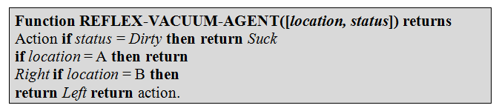
2.1 Introduction 2.1.1 Agent Terminology
2.1.2 Environment of Problem
2.1.3 Vacuum cleaner problem
2.2 Structure of Agent
2.2.1 PAGE
2.2.2 Agent program
2.2.3 Attributes of Agents
2.3 Rationality
2.3.1 Rational Agent
2.3.2 Ideal rational agent
2.3.3 Autonomy
2.4 Types of Agent
2.5 Environment and properties
2.6 PEAS for Agent
2.7 Intelligent agent application
Environment of problem
The vacuum agent perceives in which square it is in and if there is dirt in the square. It may choose to move left, right or suck up the dirt or do nothing. On the basis of the aforementioned task, one of the very simple functions of the agent is the following: If the current square is dirty then suck, otherwise move to other square. Hence, we can write:
Precepts: location and status, e.g., [A, Dirty]
Actions: left, right, suck and no-op (Do Nothing)

Slide 8
2.1 Introduction 2.1.1 Agent Terminology
2.1.2 Environment of Problem
2.1.3 Vacuum cleaner problem
2.2 Structure of Agent
2.2.1 PAGE
2.2.2 Agent program
2.2.3 Attributes of Agents
2.3 Rationality
2.3.1 Rational Agent
2.3.2 Ideal rational agent
2.3.3 Autonomy
2.4 Types of Agent
2.5 Environment and properties
2.6 PEAS for Agent
2.7 Intelligent agent application
Vacuum cleaner problem
Performance measure of vacuum cleaner agent: All the rooms are well cleaned.
Behaviour/action of agent: Left, right, suck and no-op (Doing nothing).
Percept: Location and status, for example, [A, Dirty].
Agent function: Mapping of precept sequence to an action

Slide 9
Vacuum cleaner problem
2.1 Introduction 2.1.1 Agent Terminology
2.1.2 Environment of Problem
2.1.3 Vacuum cleaner problem
2.2 Structure of Agent
2.2.1 PAGE
2.2.2 Agent program
2.2.3 Attributes of Agents
2.3 Rationality
2.3.1 Rational Agent
2.3.2 Ideal rational agent
2.3.3 Autonomy
2.4 Types of Agent
2.5 Environment and properties
2.6 PEAS for Agent
2.7 Intelligent agent application
Percept sequence
Percept sequence | Action
[A, Clean] | Right
[A, Dirty] | Suck
[B, Clean] | Left
[B, Dirty] | Suck
[A, Dirty], [A, Clean] | Right
[A, Clean], [B, Dirty] | Suck
[B, Dirty], [B, Clean] | Left
[B, Clean], [A, Dirty] | Suck
[A, Clean], [B, Clean] | No-op
[B, Clean], [A, Clean] | No-op

Slide 10
2.1 Introduction 2.1.1 Agent Terminology
2.1.2 Environment of Problem
2.1.3 Vacuum cleaner problem
2.2 Structure of Agent
2.2.1 PAGE
2.2.2 Agent program
2.2.3 Attributes of Agents
2.3 Rationality
2.3.1 Rational Agent
2.3.2 Ideal rational agent
2.3.3 Autonomy
2.4 Types of Agent
2.5 Environment and properties
2.6 PEAS for Agent
2.7 Intelligent agent application
Structure of agent
The structure of agent can be represented as:
Agent= Architecture + Agent
Program where,
Architecture : The machinery that an agent executes on
Agent program: An implementation of an agent function

Slide 11
2.1 Introduction 2.1.1 Agent Terminology
2.1.2 Environment of Problem
2.1.3 Vacuum cleaner problem
2.2 Structure of Agent
2.2.1 PAGE
2.2.2 Agent program
2.2.3 Attributes of Agents
2.3 Rationality
2.3.1 Rational Agent
2.3.2 Ideal rational agent
2.3.3 Autonomy
2.4 Types of Agent
2.5 Environment and properties
2.6 PEAS for Agent
2.7 Intelligent agent application
PAGE
While designing the intelligent systems, there are following four main factors to be considered
P, Percepts: The inputs to the AI system.
A, Actions: The outputs of the AI system.
G, Goals: What the agent is expected to achieve.
E, Environment: What the agent is interacting with one.

Slide 12
2.1 Introduction 2.1.1 Agent Terminology
2.1.2 Environment of Problem
2.1.3 Vacuum cleaner problem
2.2 Structure of Agent
2.2.1 PAGE
2.2.2 Agent program
2.2.3 Attributes of Agents
2.3 Rationality
2.3.1 Rational Agent
2.3.2 Ideal rational agent
2.3.3 Autonomy
2.4 Types of Agent
2.5 Environment and properties
2.6 PEAS for Agent
2.7 Intelligent agent application
Agent type | Percepts | Actions | Goals | Environment
Medical diagnostic system | Symptoms, test results, patient’s answers | Questions, test requests, treatments, referrals | Healthy patients, minimise the costs | Patient, hospital, staff
Satellite image analysis system | Pixels of varying intensity and colour | Display a categorisation of the scene | Correct image categorisation | Images from orbiting satellite
Part-picking robot | Pixels of varying intensity and colour | Pick up parts and sort them into bins | Place parts into correct bins | Conveyor belt with parts, bins
Refinery controller | Temperature, pressure and chemical readings | Open and close valves, adjust temperature | Maximise purity, yield, safety | Refinery, staff
Interactive | Typed words | Display exercises, | Maximise | Set of students,

Slide 13
2.1 Introduction 2.1.1 Agent Terminology
2.1.2 Environment of Problem
2.1.3 Vacuum cleaner problem
2.2 Structure of Agent
2.2.1 PAGE
2.2.2 Agent program
2.2.3 Attributes of Agents
2.3 Rationality
2.3.1 Rational Agent
2.3.2 Ideal rational agent
2.3.3 Autonomy
2.4 Types of Agent
2.5 Environment and properties
2.6 PEAS for Agent
2.7 Intelligent agent application
Agent program
The skeleton of the IAs accept the percept’s from the environment and actions are generated.
Firstly, although agent mapping is defined as the function from the percept sequence to actions, the agent mapping accepts only a single percept as its input
Secondly, the measure of goal or performance is not the part of skeleton program, since the performance measure is enforced externally to understand the behaviour of an agent, and it is also often possible to attain high performance without an explicit knowledge of measuring the performance.

Slide 14
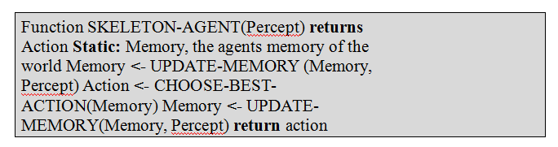
2.1 Introduction 2.1.1 Agent Terminology
2.1.2 Environment of Problem
2.1.3 Vacuum cleaner problem
2.2 Structure of Agent
2.2.1 PAGE
2.2.2 Agent program
2.2.3 Attributes of Agents
2.3 Rationality
2.3.1 Rational Agent
2.3.2 Ideal rational agent
2.3.3 Autonomy
2.4 Types of Agent
2.5 Environment and properties
2.6 PEAS for Agent
2.7 Intelligent agent application
Agent program
On each invocation, the memory of the agent is updated to mirror the new percept, the best action selected and the fact that the action was taken is also stored inside the memory. The memory persists from one invocation to the next.

Slide 15
2.1 Introduction 2.1.1 Agent Terminology
2.1.2 Environment of Problem
2.1.3 Vacuum cleaner problem
2.2 Structure of Agent
2.2.1 PAGE
2.2.2 Agent program
2.2.3 Attributes of Agents
2.3 Rationality
2.3.1 Rational Agent
2.3.2 Ideal rational agent
2.3.3 Autonomy
2.4 Types of Agent
2.5 Environment and properties
2.6 PEAS for Agent
2.7 Intelligent agent application
Attributes of agent
Autonomy: Agent work without the direct interference of the people or others and have some kind of control over their action and the internal state.
Social ability: Agent’s interface with different agents and human by the means or specific likeness of agent communication language.
Reactivity: Agents perceive their condition which might include the physical world, client by the means of graphical user interface, an accumulation of agent.
Proactively: Agents do not simply act in response to their environment; but these are able to exhibit goal–director behavior by taking initiative.
Goal orienteer: An agent is efficient of handling complex high-level tasks. The decision for how such a task is best split into smaller subtasks, and in which order and manner these subtasks should be composed by the agents itself.

Slide 16
2.1 Introduction 2.1.1 Agent Terminology
2.1.2 Environment of Problem
2.1.3 Vacuum cleaner problem
2.2 Structure of Agent
2.2.1 PAGE
2.2.2 Agent program
2.2.3 Attributes of Agents
2.3 Rationality
2.3.1 Rational Agent
2.3.2 Ideal rational agent
2.3.3 Autonomy
2.4 Types of Agent
2.5 Environment and properties
2.6 PEAS for Agent
2.7 Intelligent agent application
Rationality
Rationality is defined as the only status of being sensible and with great judgmental feeling. Rationality is only related to the expected activities or actions and this results relying on what the IA has viewed.
Performing activities with the point of obtaining the valuable data is said to be a critical piece of rationality.
Rational Agent
A right action is always performed by a rational agent, where the right action is equivalent to the action that causes the agent to be most successful in the given percept sequence. The problem the agent solves is characterised by the performance measure, environment, actuators and sensors (PEAS).

Slide 17
2.1 Introduction 2.1.1 Agent Terminology
2.1.2 Environment of Problem
2.1.3 Vacuum cleaner problem
2.2 Structure of Agent
2.2.1 PAGE
2.2.2 Agent program
2.2.3 Attributes of Agents
2.3 Rationality
2.3.1 Rational Agent
2.3.2 Ideal rational agent
2.3.3 Autonomy
2.4 Types of Agent
2.5 Environment and properties
2.6 PEAS for Agent
2.7 Intelligent agent application
Rational agent
Rationality of an agent depends on mainly on the following four parameters:
The degree of success that is determined by the performance measures.
The percept sequence of the agent that have been perceived till date.
Prior knowledge of the environment that is gained by an agent till date.
The actions that the agent might perform in the environment.

Slide 18
2.1 Introduction 2.1.1 Agent Terminology
2.1.2 Environment of Problem
2.1.3 Vacuum cleaner problem
2.2 Structure of Agent
2.2.1 PAGE
2.2.2 Agent program
2.2.3 Attributes of Agents
2.3 Rationality
2.3.1 Rational Agent
2.3.2 Ideal rational agent
2.3.3 Autonomy
2.4 Types of Agent
2.5 Environment and properties
2.6 PEAS for Agent
2.7 Intelligent agent application
Ideal rational agent
An ideal rational agent is the one, which is competent enough of performing expected actions to expand its performance measure, on the basis of the following:
Its percept sequence.
Its built-in knowledge base.
Autonomy
If the behaviour of the system is determined by its own experience, the system is known as autonomous. When the agent has very less experience, it will be required to act in a random manner unless some assistance is provided either by the designer or the programmer. An actual autonomous IAs would be able to successfully and efficiently show all types of the environ-ments, given sufficient time to adapt.

Slide 19
Types of agents
2.1 Introduction 2.1.1 Agent Terminology
2.1.2 Environment of Problem
2.1.3 Vacuum cleaner problem
2.2 Structure of Agent
2.2.1 PAGE
2.2.2 Agent program
2.2.3 Attributes of Agents
2.3 Rationality
2.3.1 Rational Agent
2.3.2 Ideal rational agent
2.3.3 Autonomy
2.4 Types of Agent
2.5 Environment and properties
2.6 PEAS for Agent
2.7 Intelligent agent application
Simple reflex agent
Model based agent
Goal based agent
Utility based agent
Learning agent

Slide 20
2.1 Introduction 2.1.1 Agent Terminology
2.1.2 Environment of Problem
2.1.3 Vacuum cleaner problem
2.2 Structure of Agent
2.2.1 PAGE
2.2.2 Agent program
2.2.3 Attributes of Agents
2.3 Rationality
2.3.1 Rational Agent
2.3.2 Ideal rational agent
2.3.3 Autonomy
2.4 Types of Agent
2.5 Environment and properties
2.6 PEAS for Agent
2.7 Intelligent agent application
Types of agent
1. Simple reflex agent
Simple reflex agent is said to be the simplest kind of agent. These agents select an action based on the current percept ignoring the rest of the percept history.
These percept to action mapping which is known as condition-action rules (so-called situation–action rules, productions, or if–then rules) in the simple reflex agent. It can be represented as follows:
if {set of percepts} then {set of actions}
For example,
if it is raining then put up umbrella
or
if carin front is breaking then initiate breaking

Slide 21
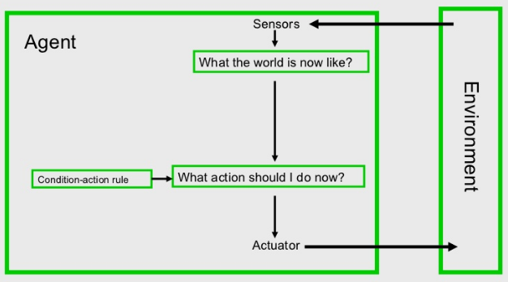
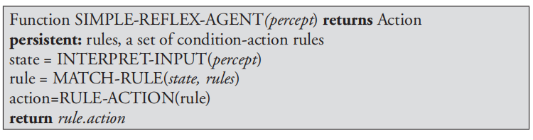
2.1 Introduction 2.1.1 Agent Terminology
2.1.2 Environment of Problem
2.1.3 Vacuum cleaner problem
2.2 Structure of Agent
2.2.1 PAGE
2.2.2 Agent program
2.2.3 Attributes of Agents
2.3 Rationality
2.3.1 Rational Agent
2.3.2 Ideal rational agent
2.3.3 Autonomy
2.4 Types of Agent
2.5 Environment and properties
2.6 PEAS for Agent
2.7 Intelligent agent application
Code for simple reflex agent

Slide 22
2.1 Introduction 2.1.1 Agent Terminology
2.1.2 Environment of Problem
2.1.3 Vacuum cleaner problem
2.2 Structure of Agent
2.2.1 PAGE
2.2.2 Agent program
2.2.3 Attributes of Agents
2.3 Rationality
2.3.1 Rational Agent
2.3.2 Ideal rational agent
2.3.3 Autonomy
2.4 Types of Agent
2.5 Environment and properties
2.6 PEAS for Agent
2.7 Intelligent agent application
Limitations
Intelligence level in these agents is very limited.
It works only in a fully observable environment.
It does not hold any knowledge or information of nonperceptual parts of state.
Because of the static knowledge based; it’s usually too big to generate and store.
If any change in the environment happens, the collection of the rules are required to be updated.

Slide 23
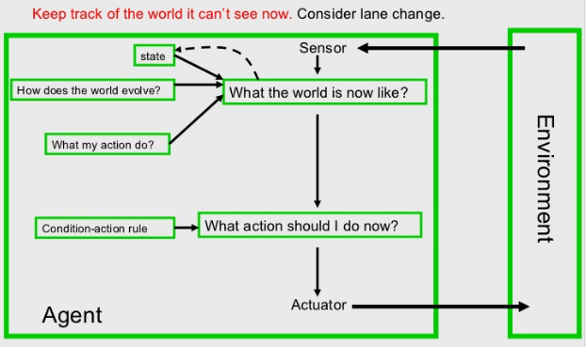
2.1 Introduction 2.1.1 Agent Terminology
2.1.2 Environment of Problem
2.1.3 Vacuum cleaner problem
2.2 Structure of Agent
2.2.1 PAGE
2.2.2 Agent program
2.2.3 Attributes of Agents
2.3 Rationality
2.3.1 Rational Agent
2.3.2 Ideal rational agent
2.3.3 Autonomy
2.4 Types of Agent
2.5 Environment and properties
2.6 PEAS for Agent
2.7 Intelligent agent application
2. Model based agent
Model-based agent is known as Reflex agents with an internal state. One problem with the simple reflex agents is that their activities are dependent of the recent data provided by their sensors. On the off chance that a reflex agent could monitor its past states (that is, keep up a portrayal or “model” of its history in the world), and understand about the development of the world.

Slide 24
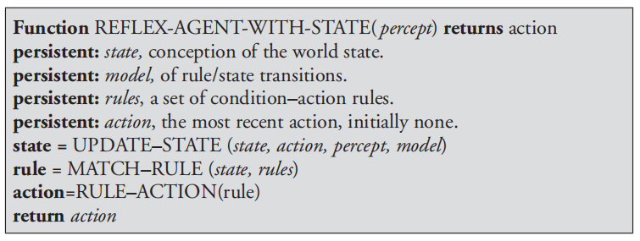
2.1 Introduction 2.1.1 Agent Terminology
2.1.2 Environment of Problem
2.1.3 Vacuum cleaner problem
2.2 Structure of Agent
2.2.1 PAGE
2.2.2 Agent program
2.2.3 Attributes of Agents
2.3 Rationality
2.3.1 Rational Agent
2.3.2 Ideal rational agent
2.3.3 Autonomy
2.4 Types of Agent
2.5 Environment and properties
2.6 PEAS for Agent
2.7 Intelligent agent application
Code for model based agent

Slide 25
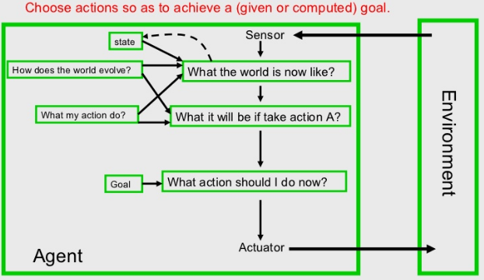
2.1 Introduction 2.1.1 Agent Terminology
2.1.2 Environment of Problem
2.1.3 Vacuum cleaner problem
2.2 Structure of Agent
2.2.1 PAGE
2.2.2 Agent program
2.2.3 Attributes of Agents
2.3 Rationality
2.3.1 Rational Agent
2.3.2 Ideal rational agent
2.3.3 Autonomy
2.4 Types of Agent
2.5 Environment and properties
2.6 PEAS for Agent
2.7 Intelligent agent application
3. Goal based
Indeed, even with the expanded information of the current situation of the world given by an agent’s internal state, the agent may not, in any case, have enough data to reveal to it. The proper action for the agent will regularly depend upon its goals .Thus, it must be provided with some goal information.

Slide 26
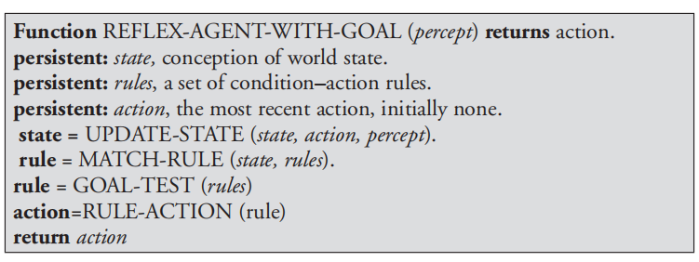
2.1 Introduction 2.1.1 Agent Terminology
2.1.2 Environment of Problem
2.1.3 Vacuum cleaner problem
2.2 Structure of Agent
2.2.1 PAGE
2.2.2 Agent program
2.2.3 Attributes of Agents
2.3 Rationality
2.3.1 Rational Agent
2.3.2 Ideal rational agent
2.3.3 Autonomy
2.4 Types of Agent
2.5 Environment and properties
2.6 PEAS for Agent
2.7 Intelligent agent application
Code for goal based agent

Slide 27
2.1 Introduction 2.1.1 Agent Terminology
2.1.2 Environment of Problem
2.1.3 Vacuum cleaner problem
2.2 Structure of Agent
2.2.1 PAGE
2.2.2 Agent program
2.2.3 Attributes of Agents
2.3 Rationality
2.3.1 Rational Agent
2.3.2 Ideal rational agent
2.3.3 Autonomy
2.4 Types of Agent
2.5 Environment and properties
2.6 PEAS for Agent
2.7 Intelligent agent application
4. Utility based agent
Goals individually are insufficient to produce top high-quality behavior. Frequently, there are numerous groupings of actions that can bring about a similar goal being accomplished. Given proper criteria, it might be conceivable to pick ‘best’ sequence of actions from a number that all result in the goal being achieved.
Any utility-based agent can be depicted as having an utility capacity that maps a state, or grouping of states, on to a genuine number that speaks to its utility or convenience or usefulness.

Slide 28
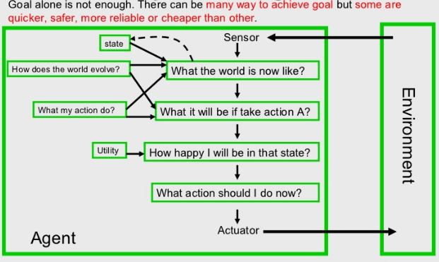
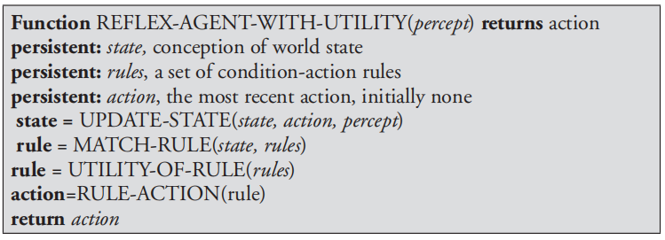
2.1 Introduction 2.1.1 Agent Terminology
2.1.2 Environment of Problem
2.1.3 Vacuum cleaner problem
2.2 Structure of Agent
2.2.1 PAGE
2.2.2 Agent program
2.2.3 Attributes of Agents
2.3 Rationality
2.3.1 Rational Agent
2.3.2 Ideal rational agent
2.3.3 Autonomy
2.4 Types of Agent
2.5 Environment and properties
2.6 PEAS for Agent
2.7 Intelligent agent application
Code for utility based agent

Slide 29
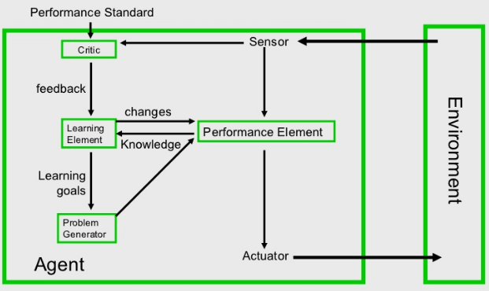
2.1 Introduction 2.1.1 Agent Terminology
2.1.2 Environment of Problem
2.1.3 Vacuum cleaner problem
2.2 Structure of Agent
2.2.1 PAGE
2.2.2 Agent program
2.2.3 Attributes of Agents
2.3 Rationality
2.3.1 Rational Agent
2.3.2 Ideal rational agent
2.3.3 Autonomy
2.4 Types of Agent
2.5 Environment and properties
2.6 PEAS for Agent
2.7 Intelligent agent application
5. Learning agent
By actively exploring and experimenting with their environment, the most powerful agents are able to learn. A learning agent can be further divided into the four conceptual components

Slide 30
2.1 Introduction 2.1.1 Agent Terminology
2.1.2 Environment of Problem
2.1.3 Vacuum cleaner problem
2.2 Structure of Agent
2.2.1 PAGE
2.2.2 Agent program
2.2.3 Attributes of Agents
2.3 Rationality
2.3.1 Rational Agent
2.3.2 Ideal rational agent
2.3.3 Autonomy
2.4 Types of Agent
2.5 Environment and properties
2.6 PEAS for Agent
2.7 Intelligent agent application
Environment and its properties
1. Accessible and Inaccessible Environments
2. Deterministic Environment and Nondeterministic Environment
3. Episodic and Nonepisodic Environment
4. Static versus Dynamic Environment
5. Discrete versus Continuous Environment
6. Single Agent versus Multiagent Environment

Slide 31
2.1 Introduction 2.1.1 Agent Terminology
2.1.2 Environment of Problem
2.1.3 Vacuum cleaner problem
2.2 Structure of Agent
2.2.1 PAGE
2.2.2 Agent program
2.2.3 Attributes of Agents
2.3 Rationality
2.3.1 Rational Agent
2.3.2 Ideal rational agent
2.3.3 Autonomy
2.4 Types of Agent
2.5 Environment and properties
2.6 PEAS for Agent
2.7 Intelligent agent application
Environment Types-I : Fully observable (accessible) vs. partially observable (inaccessible) | Environment Types-II: Deterministic vs. stochastic (non-deterministic)
Fully observable if agents sensors detect all aspects of environment relevant to choice of action Could be partially observable due to noisy, inaccurate or missing sensors, or inability to measure everything that is needed Model can keep track of what was sensed previously, cannot be sensed now, but is probably still true. Often, if other agents are involved, their intentions are not observable, but their actions are E.g chess – the board is fully observable, as are opponent’s moves. Driving – what is around the next bend is not observable (yet). | · Deterministic = the next state of the environment is completely predictable from the current state and the action executed by the agent Stochastic = the next state has some uncertainty associated with it Uncertainty could come from randomness, lack of a good environment model, or lack of complete sensor coverage Strategic environment if the environment is deterministic except for the actions of other agents Examples: Non-deterministic environment: physical world: Robot on Mars Deterministic environment: Tic Tac Toe game

Slide 32
2.1 Introduction 2.1.1 Agent Terminology
2.1.2 Environment of Problem
2.1.3 Vacuum cleaner problem
2.2 Structure of Agent
2.2.1 PAGE
2.2.2 Agent program
2.2.3 Attributes of Agents
2.3 Rationality
2.3.1 Rational Agent
2.3.2 Ideal rational agent
2.3.3 Autonomy
2.4 Types of Agent
2.5 Environment and properties
2.6 PEAS for Agent
2.7 Intelligent agent application
Environment Types-III : Episodic vs. sequential | Environment Types-IV: Discrete vs. continuous
The agent's experience is divided into atomic "episodes" (each episode consists of the agent perceiving and then performing a single action) and the choice of action in each episode depends only on the episode itself Sequential if current decisions affect future decisions, or rely on previous ones Examples of episodic are expert advice systems – an episode is a single question and answer Most environments (and agents) are sequential Many are both – a number of episodes containing a number of sequential steps to a conclusion Examples: Episodic environment: mail sorting system Non-episodic environment: chess game | Discrete = time moves in fixed steps, usually with one measurement per step (and perhaps one action, but could be no action). E.g. a game of chess Continuous = Signals constantly coming into sensors, actions continually changing. E.g. driving a car

Slide 33
2.1 Introduction 2.1.1 Agent Terminology
2.1.2 Environment of Problem
2.1.3 Vacuum cleaner problem
2.2 Structure of Agent
2.2.1 PAGE
2.2.2 Agent program
2.2.3 Attributes of Agents
2.3 Rationality
2.3.1 Rational Agent
2.3.2 Ideal rational agent
2.3.3 Autonomy
2.4 Types of Agent
2.5 Environment and properties
2.6 PEAS for Agent
2.7 Intelligent agent application
Environment types-V: Static vs. dynamic: | Environment types-VI Single agent vs. multi agent:
Dynamic if the environment may change over time. Static if nothing (other than the agent) in the environment changes Other agents in an environment make it dynamic The goal might also change over time Not dynamic if the agent moves from one part of an environment to another, though it has a very similar effect E.g. – Playing football, other players make it dynamic, mowing a lawn is static (unless there is a cat…), expert systems usually static (unless knowledge changes) | An agent operating by itself in an environment is single agent! Multi agent is when other agents are present! A strict definition of an other agent is anything that changes from step to step. A stronger definition is that it must sense and act Competitive or co-operative Multi-agent environments Human users are an example of another agent in a system E.g. Other players in a football team (or opposing team), wind and waves in a sailing agent, other cars in a taxi driver

Slide 34
2.1 Introduction 2.1.1 Agent Terminology
2.1.2 Environment of Problem
2.1.3 Vacuum cleaner problem
2.2 Structure of Agent
2.2.1 PAGE
2.2.2 Agent program
2.2.3 Attributes of Agents
2.3 Rationality
2.3.1 Rational Agent
2.3.2 Ideal rational agent
2.3.3 Autonomy
2.4 Types of Agent
2.5 Environment and properties
2.6 PEAS for Agent
2.7 Intelligent agent application
 | Fully observable? | Deterministic? | Episodic? | Static? | Discrete? | Single agent?
Solitaire | No | Yes | Yes | Yes | Yes | Yes
Backgammon | Yes | No | No | Yes | Yes | No
Taxi driving | No | No | No | No | No | No
Internet shopping | No | No | No | No | Yes | No
Medical diagnosis | No | No | No | No | No | Yes
Crossword puzzle | Yes | Yes | Yes | Yes | Yes | Yes
English tutor | No | No | No | No | Yes | No
Image analysis | Yes | Yes | Yes | No | No | Yes

Slide 35
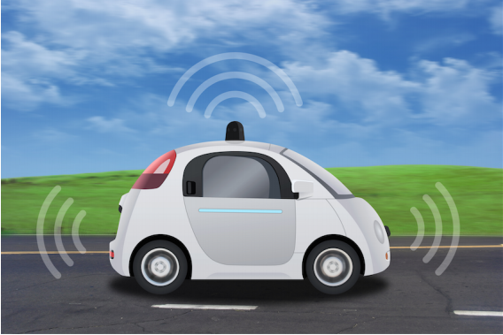
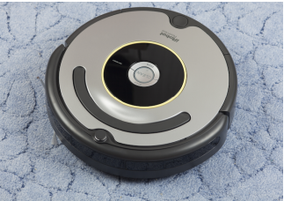
PEAS for Agent
2.1 Introduction 2.1.1 Agent Terminology
2.1.2 Environment of Problem
2.1.3 Vacuum cleaner problem
2.2 Structure of Agent
2.2.1 PAGE
2.2.2 Agent program
2.2.3 Attributes of Agents
2.3 Rationality
2.3.1 Rational Agent
2.3.2 Ideal rational agent
2.3.3 Autonomy
2.4 Types of Agent
2.5 Environment and properties
2.6 PEAS for Agent
2.7 Intelligent agent application
PEAS Descriptors for automated Taxi Driver
Performance Measure | Safety, time, legal drive, comfort
Environment | Roads, other cars, pedestrians, road signs
Actuators | Steering, accelerator, brake, signal, horn
Sensors | Camera, sonar, GPS, Speedometer, odometer, accelerometer, engine sensors, keyboard
PEAS for vacuum cleaner
Performance Measure | cleanness, efficiency: distance traveled to clean, battery life, security
Environment | room, table, wood floor, carpet, different obstacles
Actuators | wheels, different brushes, vacuum extractor
Sensors | camera, dirt detection sensor, cliff sensor, bump sensors, infrared wall sensors

Slide 36
2.1 Introduction 2.1.1 Agent Terminology
2.1.2 Environment of Problem
2.1.3 Vacuum cleaner problem
2.2 Structure of Agent
2.2.1 PAGE
2.2.2 Agent program
2.2.3 Attributes of Agents
2.3 Rationality
2.3.1 Rational Agent
2.3.2 Ideal rational agent
2.3.3 Autonomy
2.4 Types of Agent
2.5 Environment and properties
2.6 PEAS for Agent
2.7 Intelligent agent application
Intelligent agent application
1. Systems and network management
2. Information access and management
3. Work flow and administrative management
4. Customer help desk
5. Personal shopping assistant

Slide 37

Dr. Nilakshi Jain Email ID : nilakshijain1986@gmail.com
Thank you

